Slide 1
IPv6

Slide 2
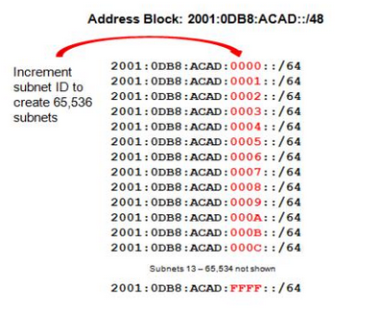
IPv6
128bit adres
8x16bit X:X:X:X:X:X:X:X
X:X:X:X:X:X:X:X
network
host
X:X:X:X:X:X:X:X
65.536 subnet
prefix
subnet
host

Slide 3
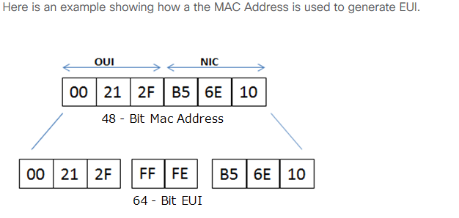
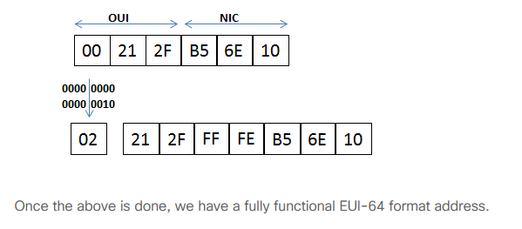
MAC’ten Auto Generate
Extended Unique Identifier (EUI), as per RFC2373, allows a host to assign itself a unique 64-Bit IP Version 6 interface identifier (EUI-64).
7. Bit Dönüşümü

Slide 4
Deneyin
https://subnettingpractice.com/ipv6.html

